Slide 1
SENTIMENT ANALYSIS USING svc
Convex Optimization – Autumn 2021
Team Members: Carlos Ramos, Cesar Contreras, Hector Estrada, Adrian Ramos, Yared Flores

Slide 2
Objectives
The present's project idea consists to use techniques of Natural Language Processing to run a sentiment analysis under the constraint of a supervised model that can predict whether the customer review was a positive or a negative one.
Will demonstrate how the use of natural language processing techniques can produce the right input for a SVM analysis for classification
Will show the results obtained by SVM and contrast the accuracy of the model via a supervised approach
Will tune hyperparameters model to obtain the best optimal parameters.

Slide 3
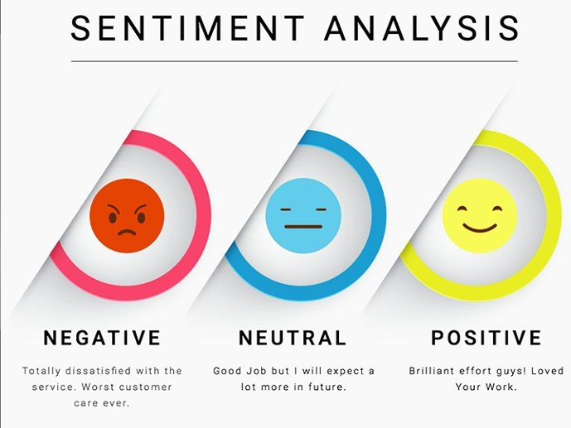
Sentiment Analysis
The aim of sentiment analysis is to define automatic tools able to extract subjective information from texts in natural language, such as opinions and sentiments, so as to create structured and actionable knowledge to be used by either a decision support system or a decision maker.

Slide 4
Theoretical Framework - Support Vector Machines
Support vector machines (SVMs) are a set of supervised learning methods used for classification, regression and outliers detection.
The advantages of support vector machines are:
Effective in high dimensional spaces.
Still effective in cases where number of dimensions is greater than the number of samples.
Uses a subset of training points in the decision function (called support vectors), so it is also memory efficient.
The disadvantages of support vector machines include:
If the number of features is much greater than the number of samples, avoid over-fitting in choosing Kernel functions and regularization term is crucial.
SVMs do not directly provide probability estimates, these are calculated using an expensive five-fold cross-validation (see Scores and probabilities, below).

Slide 5
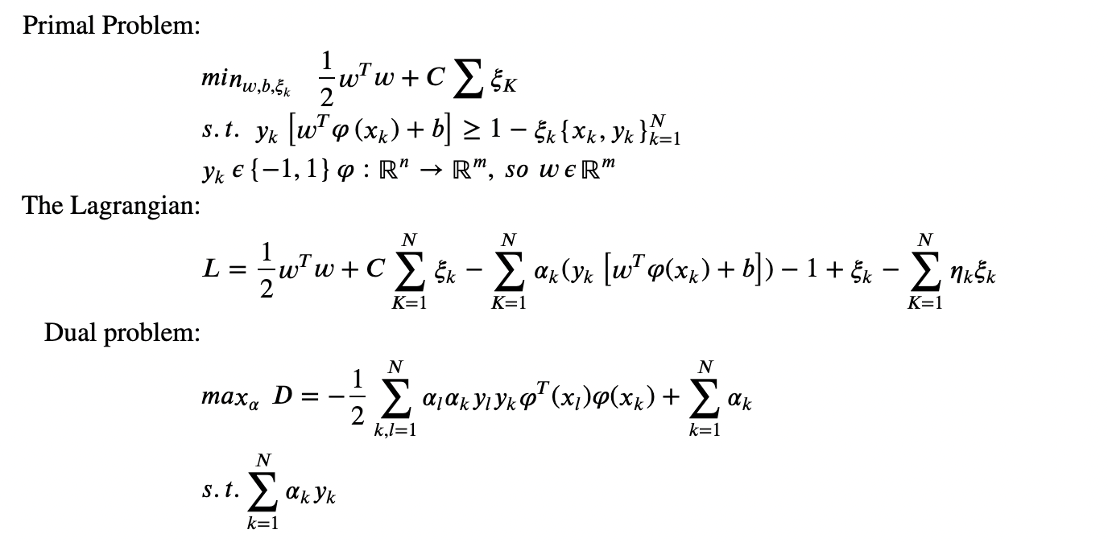
Mathematical Model

Slide 6
Theoretical Framework - Vectorization
TfidfVectorizer
In this case we are going to apply the TfidfVectorizer, the text must be parsed to remove words (tokenization), also words need to be encoded as integer or floating points values for use as inputo to the algorithm.
CountVectorizer
Convert a collection of tect documents to a matrix of token counts, this implementation produce a sparse representation of the counts using matrix
Ngrams
Ngrams are continuous sequences of n-itesms in a sentences

Slide 7

Descriptive Analysis
A dataset from Kaggle Web Site was employed for the purpose of this project. This dataset defines the next set of features/variables:
Product Name
Brand Name
Price
Rating
Reviews
Votes
Rating variable is a categorical variable that stores a numerical values from a scale of 1 to 5.
Review is the dataset feature that holds the raw text for the comments posted by every customer.

Slide 8
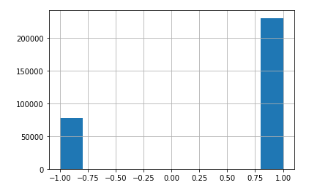
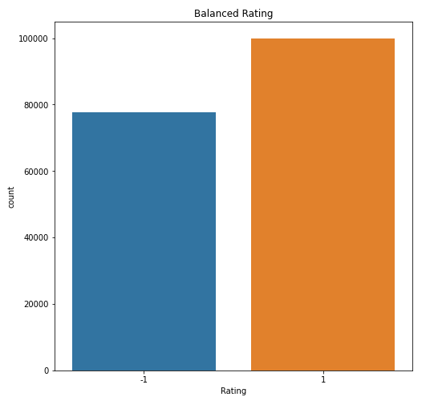
Dataset & Pre-processing
Before Preprocessing:
The dataset contains 413,840 rows by 6 columns.
Pre-processing steps:
We delete all missing values from the dataset.
Transformed the rating values from amazing rating scale to -1 and 1
Ballancing class distribution (Undersampling)
After Preprocessing:

Slide 9
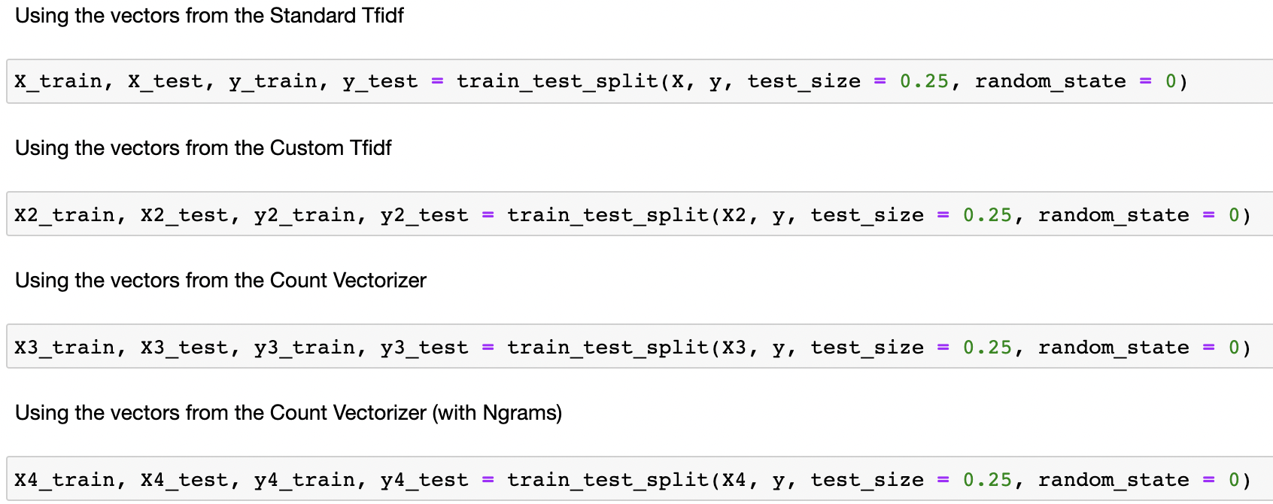
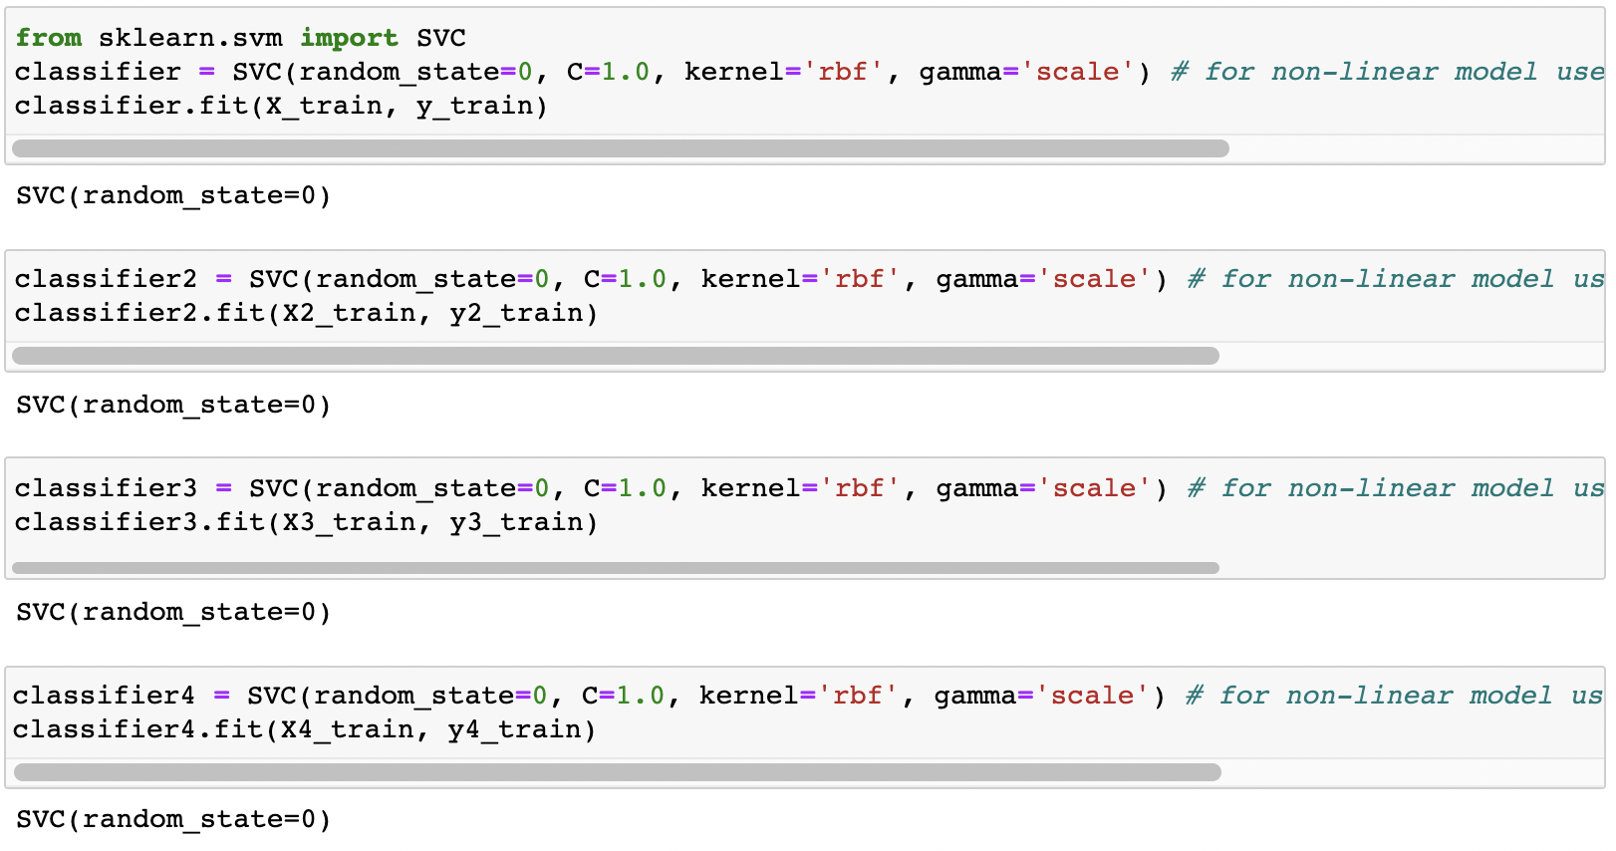
Data Splitting & Modeling
Model 1 is using Basic TfidfVectorizer
Model 2 is a Custom TfidfVectorizer, does not contain punctuations and stop words (includes stemming procedure)
Model 3 was done with CountVectorizer
Model 4 is using Ngrams

Slide 10
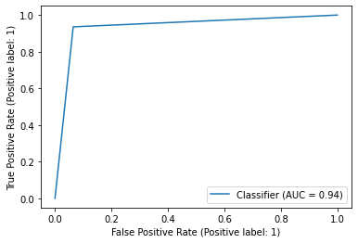
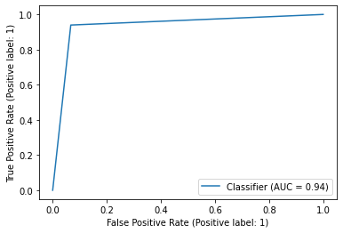
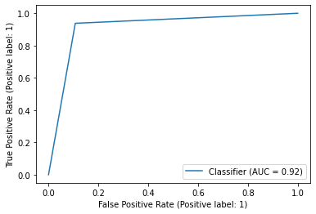
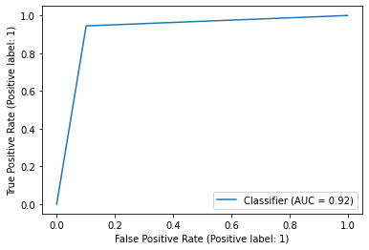
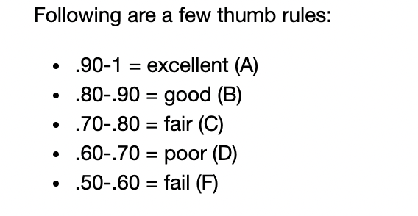
Model Performance
The ROC curve is the plot between sensitivity and (1- specificity). (1- specificity) is also known as false positive rate and sensitivity is also known as True Positive rate
AUC itself is the area under the curve.
Model 1
Model 2
Model 3
Model 4

Slide 11
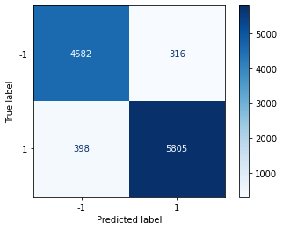
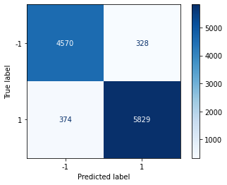
Confussion Matrix 1/2
Model 1
Model 2

Slide 12


Confussion Matrix 2/2
Model 3
Model 4

Slide 13
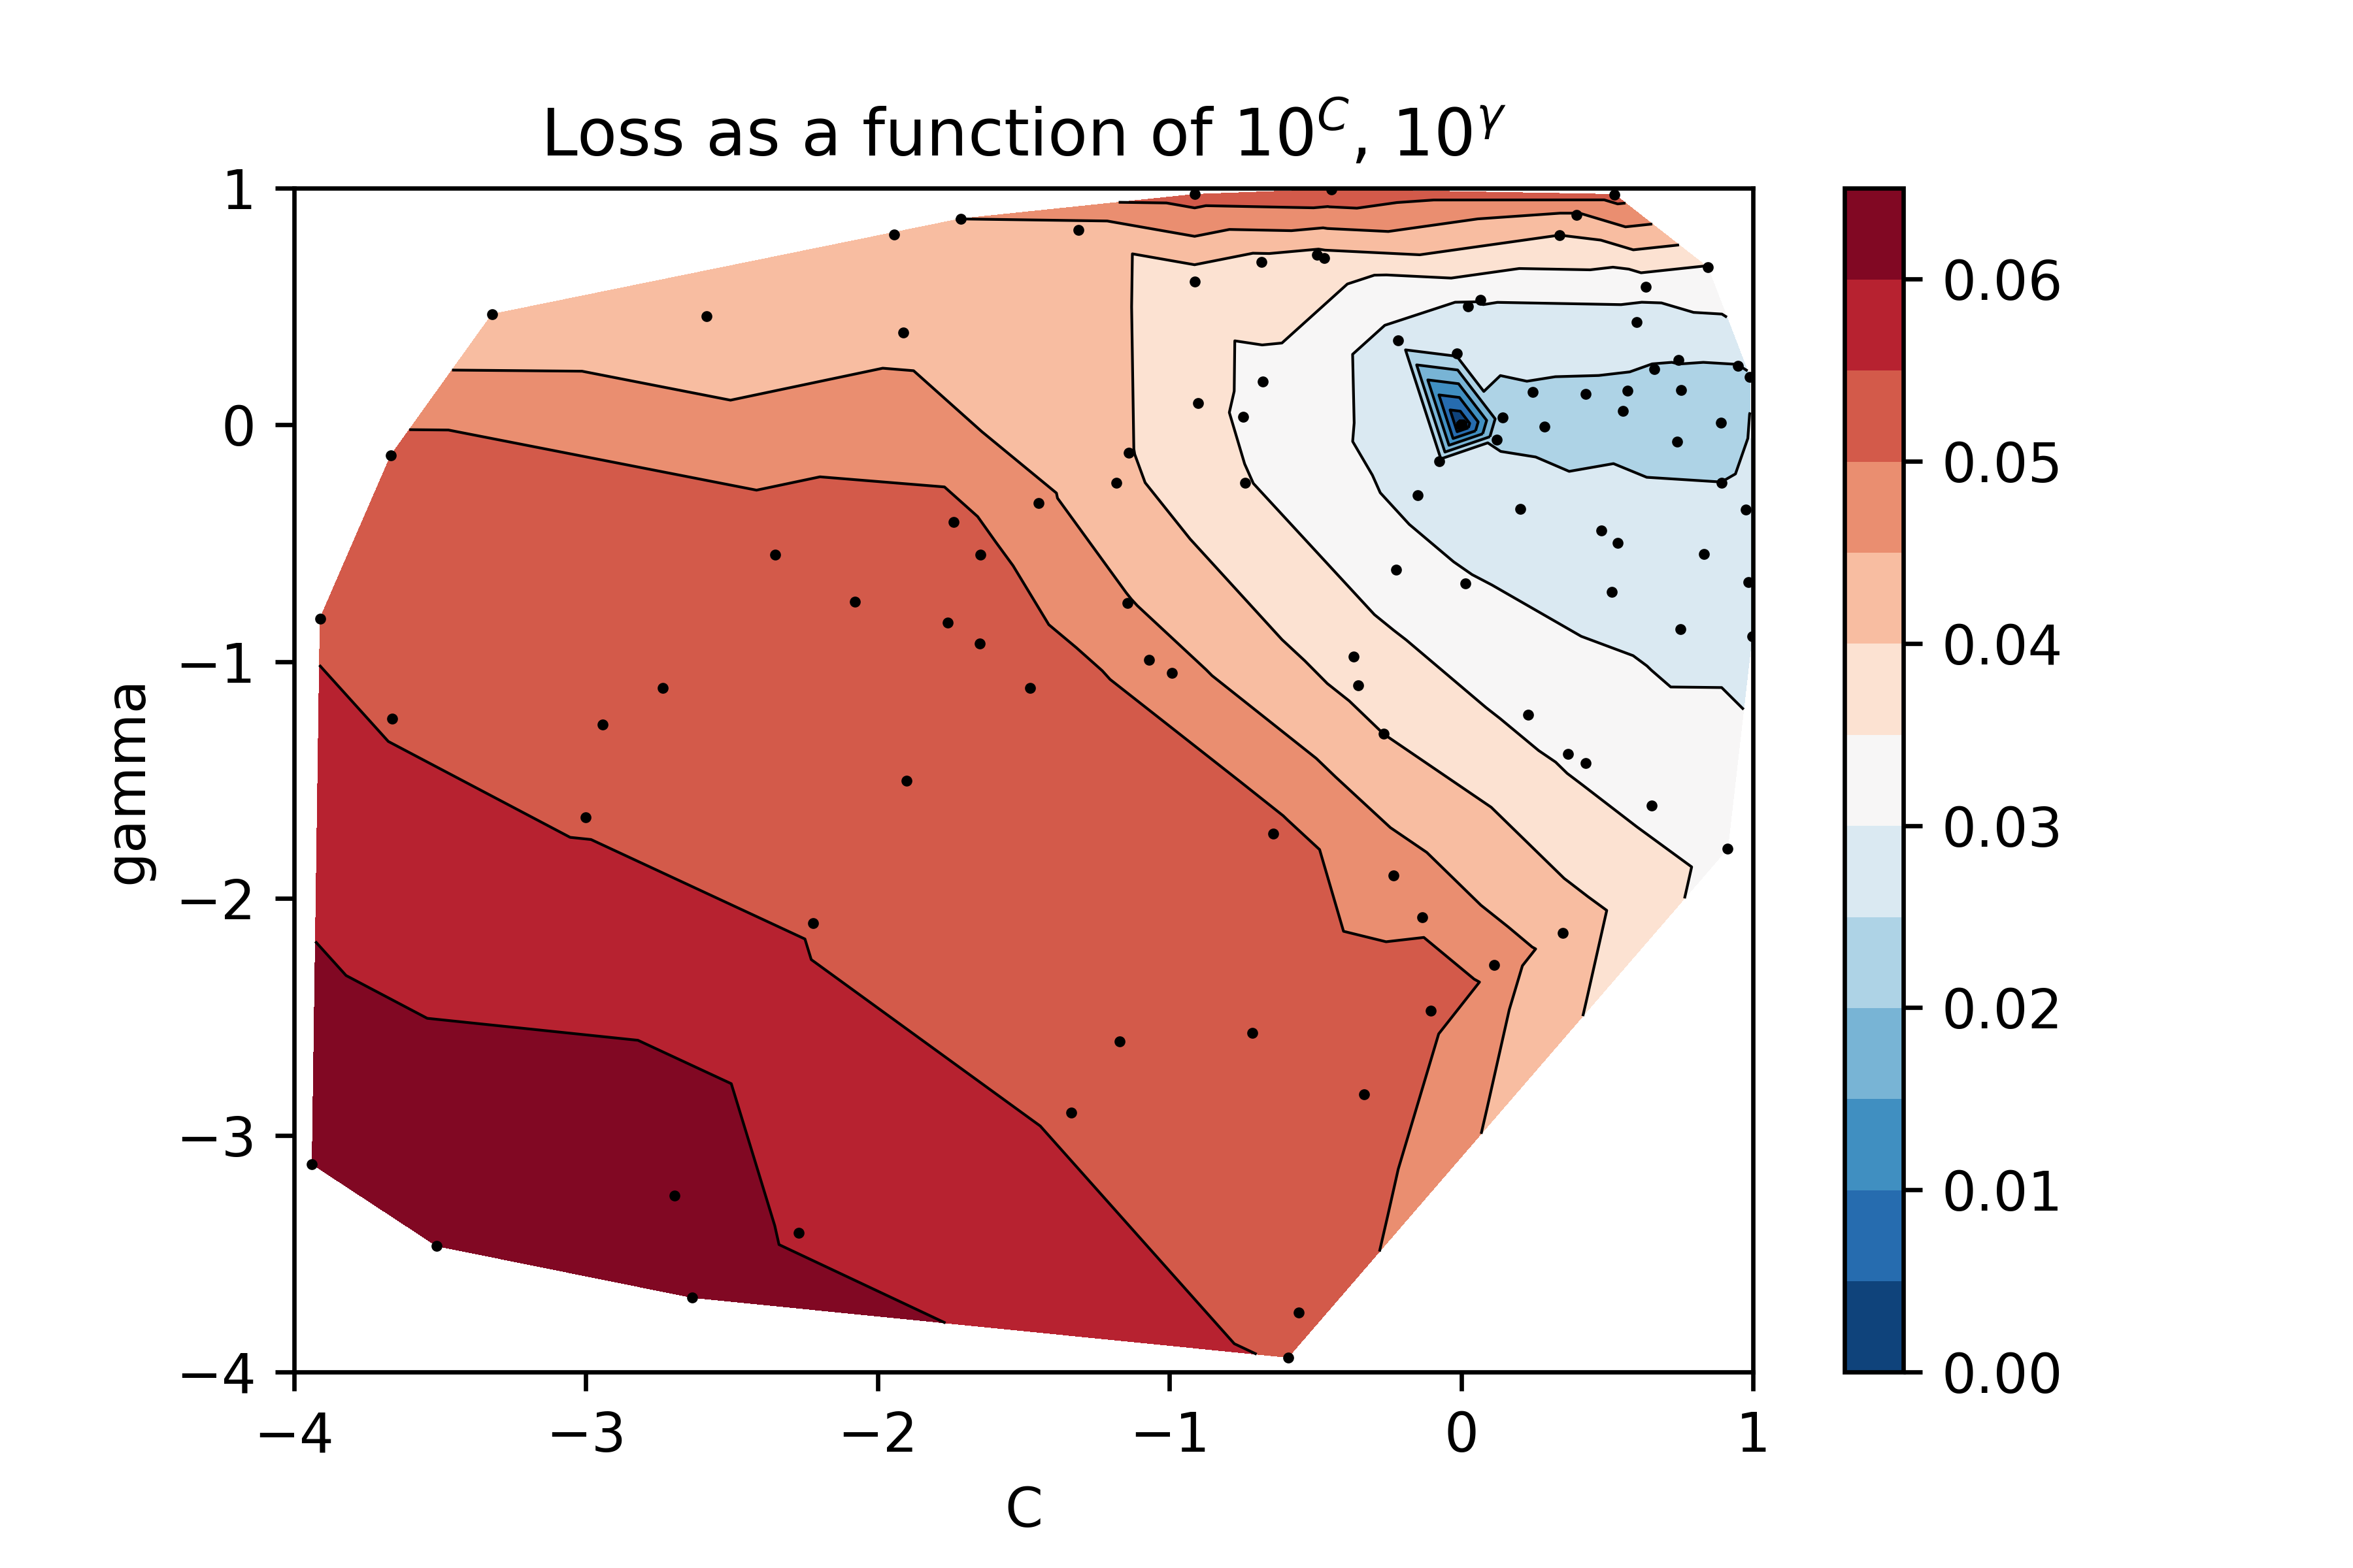
Hyper-parameters Tunning 1/4
Model 1

Slide 14
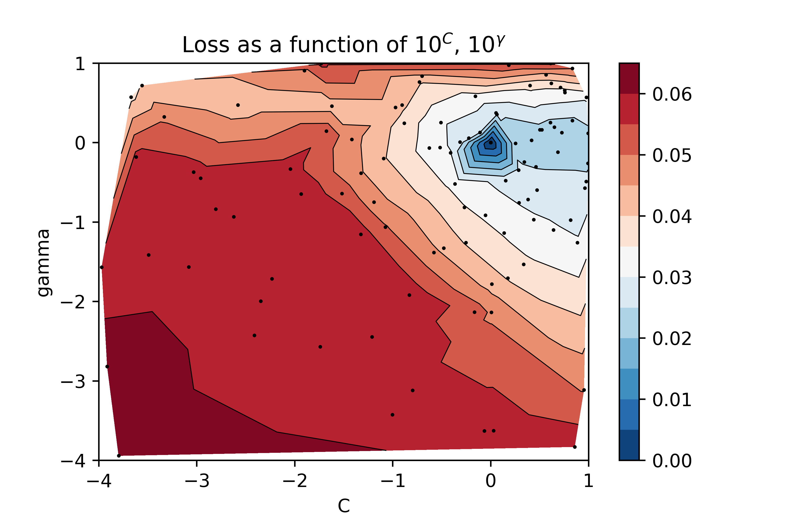
Hyper-parameters Tunning 2/4
Model 2

Slide 15
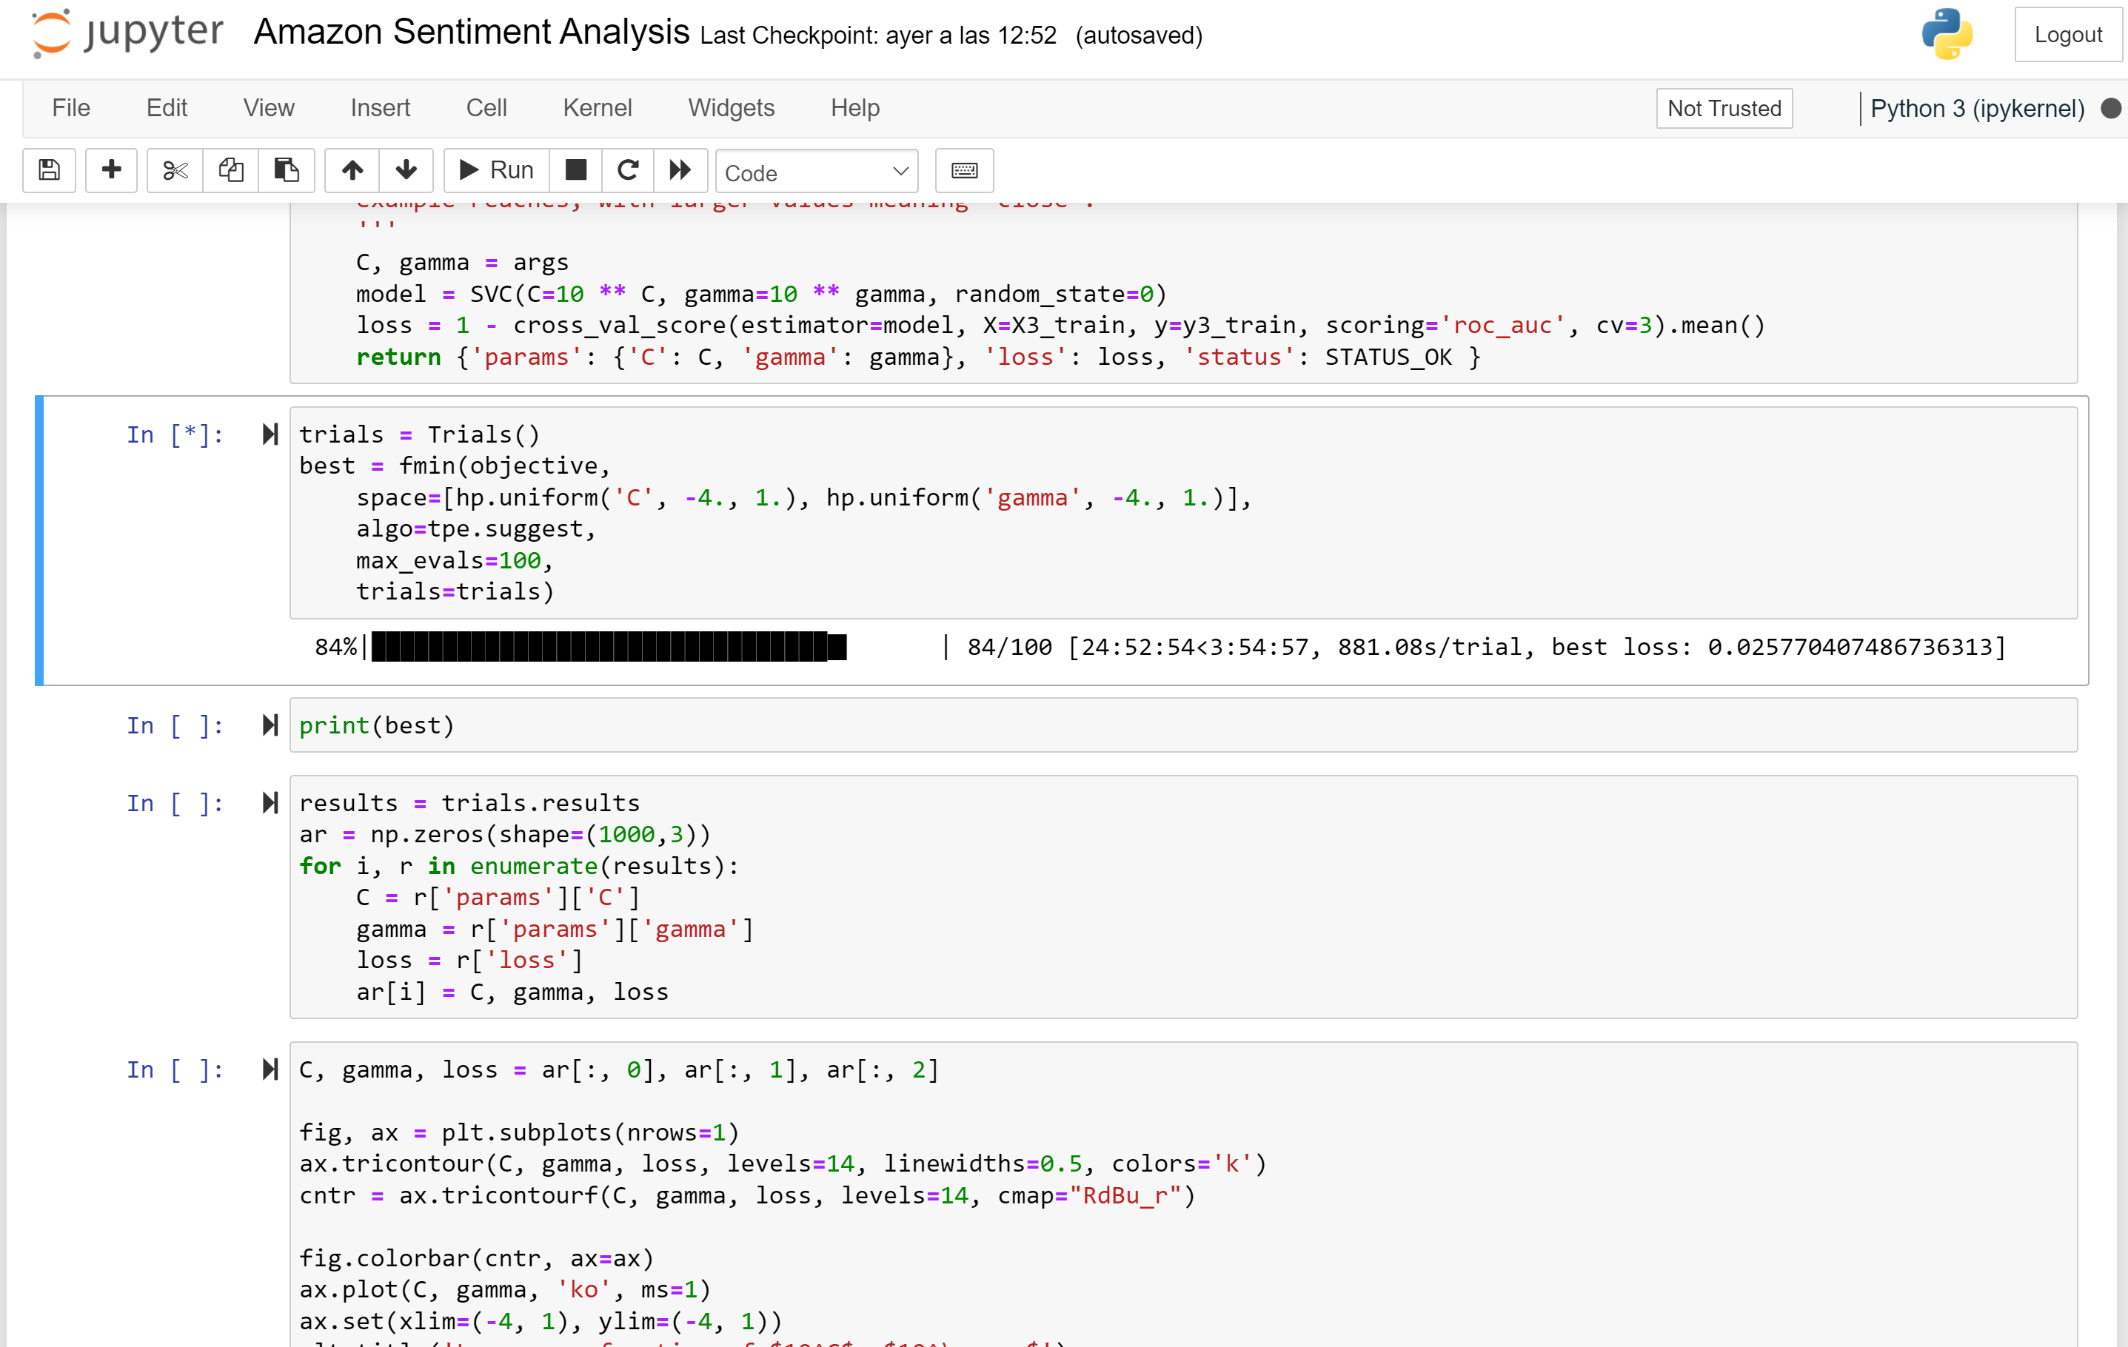
Hyper-parameters Tunning 3/4
Model 3 (Partial Results)

Slide 16
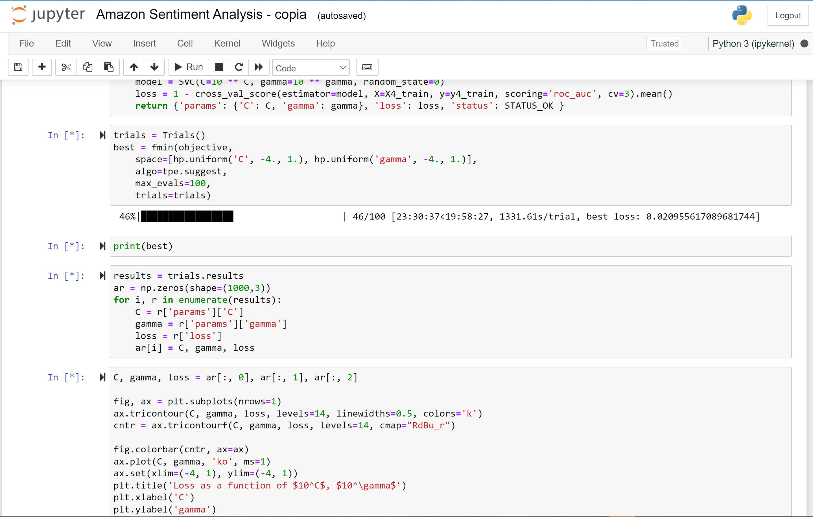
Hyper-parameters Tunning 4/4
Model 4 (Partial Results)

